Slide 1
Tomato Fired Eggs

Slide 2
Motivation:
Interested in image generation
Did research and found that DCGAN(Deep Convolutional Generative Adversarial Network) are used in image generation. (image inpainting, Gradient image generation, Separable image generation)

Slide 3
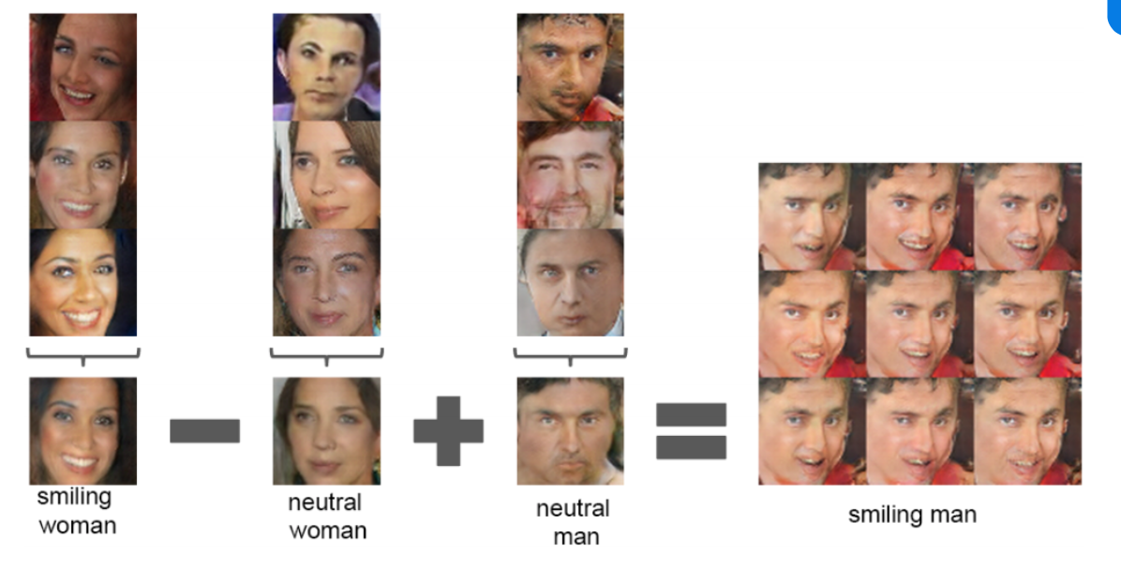
Separable image generation

Slide 4
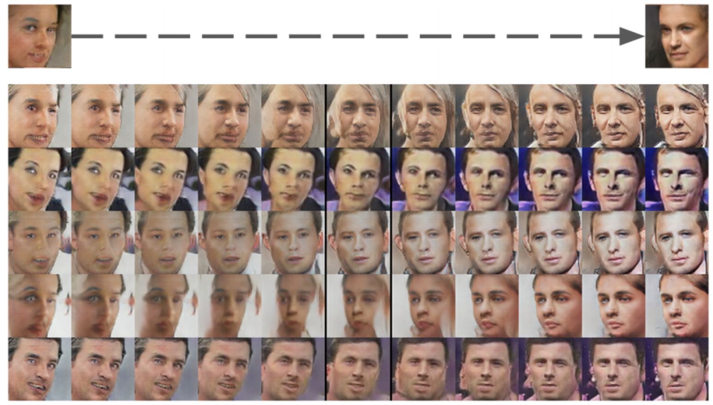
Gradient image generation

Slide 5
WHY DCGAN?
DCGAN combines Gan with CNN(Convolutional neural network), it will greatly improve the stability of the original Gan training and the quality of the generated results.

Slide 6
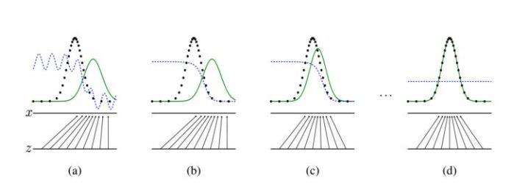
GANs
Notes:
Z: random input data
X: real data

Slide 7
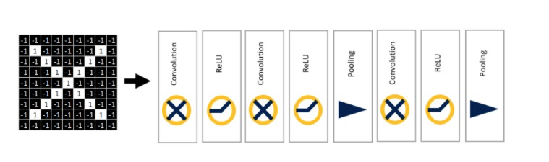
CNN
Delete the pooling, use convolution transpose instead of convolution.
Notes:
Z: random input data
X: real data

Slide 8
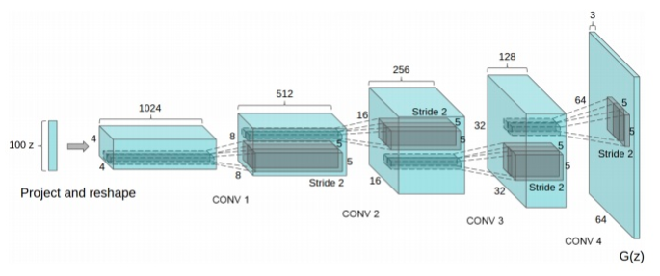
Framework
generator
discriminator
Notes:
confrontation

Slide 9
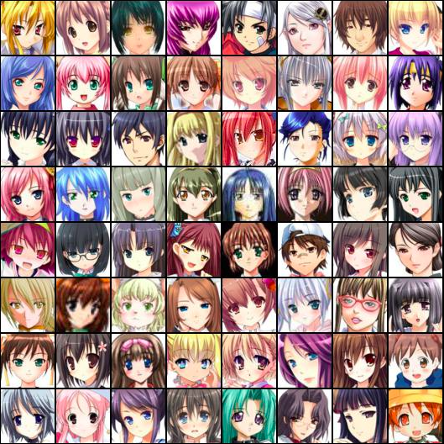
Data Set: Anime Face DataSet
Size: 63,632
https://www.kaggle.com/splcher/animefacedataset

Slide 10
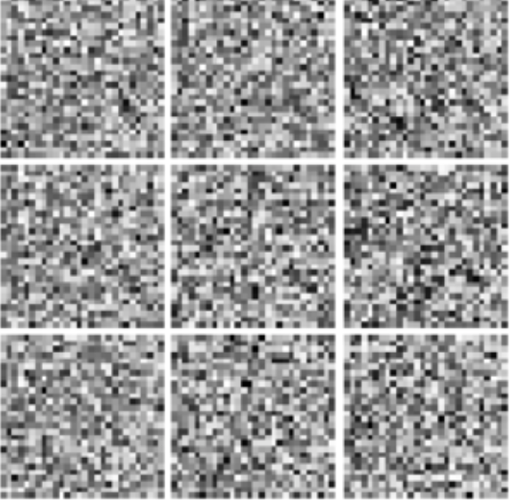
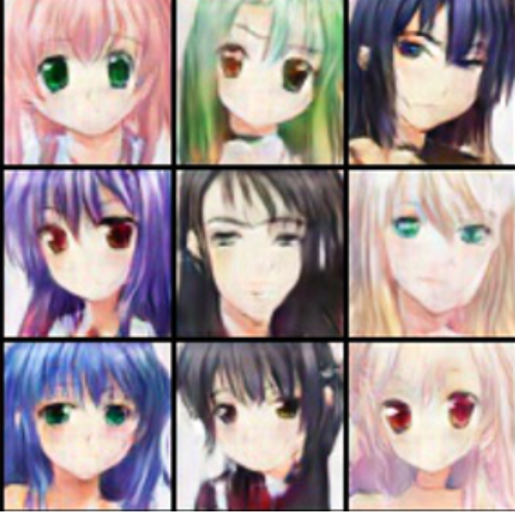
Convert noise to comic pictures

Slide 11
Input features:
Data set images (comic face)
Output prediction:
The machine imitates the original image and outputs the image it draws(fake image).

Slide 12
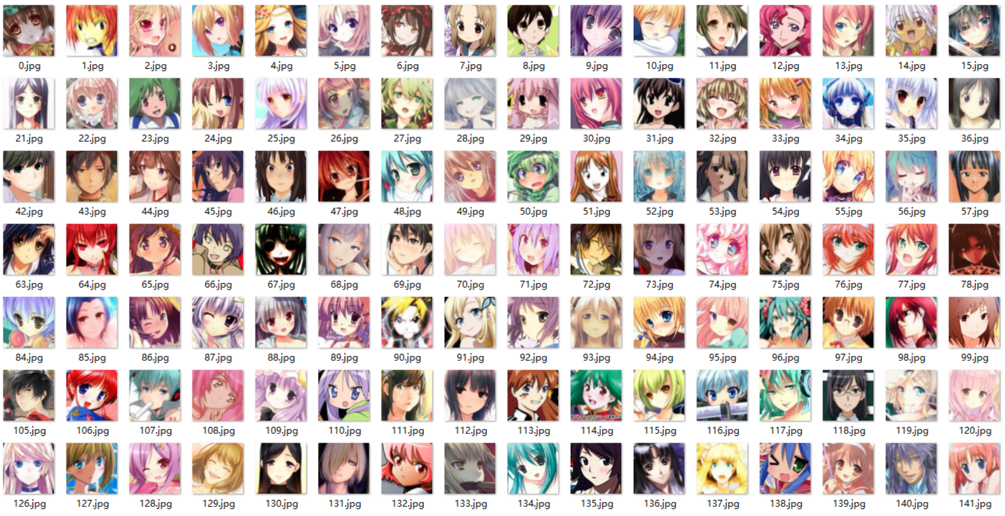
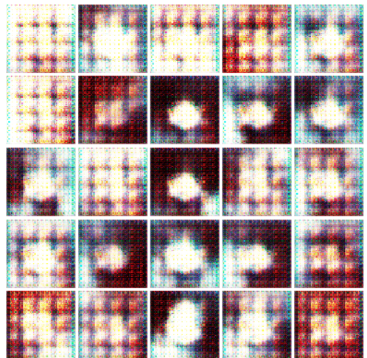
Input
Output

Slide 13
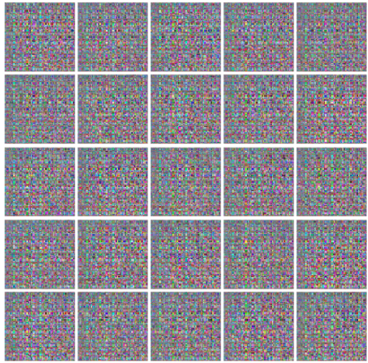
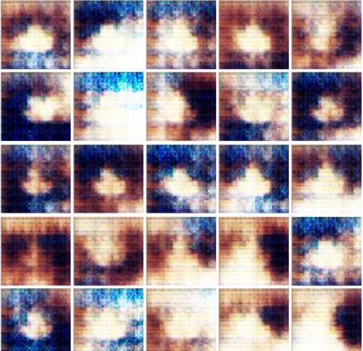
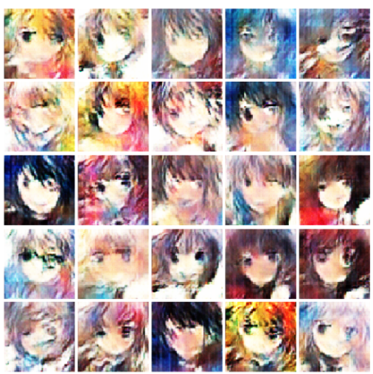
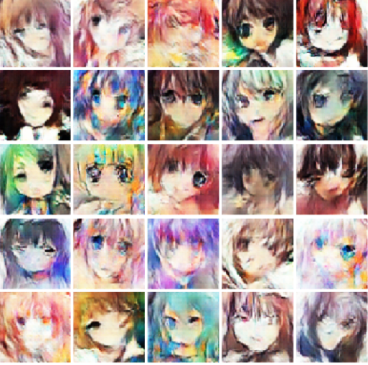
Final Product

